Slide 1

Qualitative Research
RESEARCH METHODOLOGY AND SCIENTIFIC WRITING
COMPUTER SCIENCE FACULTY, UNIVERSITY OF INDONESIA

Slide 2








Characteristics of Qualitative Method
NATURAL SETTING
RESEARCHERS AS A KEY INSTRUMENT
MULTIPLE SOURCES OF DATA
INDUCTIVE ANALYSIS
FOCUS ON EMERGENT MEANING
EVOLUTIONARY DESIGN
INTERPREIVE
HOLOSTIC AND CONTEXTUAL

Slide 3

Natural Setting
Qualitative research is performed in the field, studying a phenomenon in the context in which it occurs.

Slide 4
Researchers as a Key Instrument
Qualitative researchers collect data and information themselves (rather than through an ‘objective’ instrument),
Data is obtained through:
face-to-face interactions
observing behaviors
studying documents
interviewing participants.

Slide 5

Multiple Sources of Data
Qualitative researchers typically gather a variety of data of different sorts, from interviews to documents to observations and so forth.

Slide 6
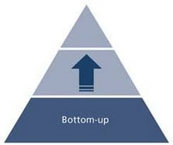
Inductive Analysis
Qualitative methods emphasize bottom-up analysis of data and the build-up of patterns, themes, and concepts into increasingly abstract units from the data.

Slide 7
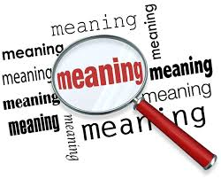
Focus on Emergent Meaning
Qualitative methods focus on uncovering or learning the meaning of behaviors, opinions, or views that participants have about a phenomenon.

Slide 8

Evolutionary Design
Qualitative methods, while following a general procedure, typically follow an evolutionary research process in which a research plan, a theory, data collection, or analysis can unfold and change over time as the research progresses.

Slide 9
Data Collection on Qualitative Research
Interviews
Observations
Remember that the researcher is part of the research
Direct observation or participant observation (Recker 2013)
Documents
The researcher’s impressions and reactions (Myers 1997)

Slide 10




Common Research Methods (Qualitative Paradigm)
CASE STUDY
ACTION RESEARCH
GROUNDED THEORY
ETHNOGRAPHY
PHENOMENOLOGY
HERMENEUTICS

Slide 11
Grounded Theory (Creswell 2002)
The researcher attempts to derive a general, abstract theory of a process, action, or interaction grounded in the views of participants in a study
Two primary characteristics of this design are:
The constant comparison of data with emerging categories
Theoretical sampling of different groups to maximize the similarities and the differences of information

Slide 12
Phenomenology
Is the study of things as they appear (phenomena) (Smith 2009).
The researcher identifies the "essence" of human experiences concerning a phenomenon, as described by participants in a study. (Creswell 2002)

Slide 13
Hermeneutics
The term ‘hermeneutic’ is derived from Greek language, that is ‘to interpret’ or ‘to understand’ (Hart 2010).
The key word of hermeneutics is interpretation (Runardotter 2007).
Hermeneutic interpretation performed with a fundamental principle called the hermeneutic circle (Klein and Myers 1999).
This principle suggests that all human understanding is achieved by iterating between considering the interdependent meaning of parts and the whole that they form (Klein and Myers 1999).
Currently, hermeneutic also be used in making the interpretation of texts in other disciplines

Slide 14
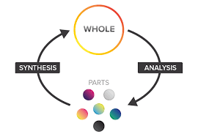
Hermeneutic Circle / Loop
Interpretations are made from a specific section ("part") and then moves to the common section ("whole"), then return from ("whole") toward ("part") (Klein and Myers 1999).
As implied in (Lukaitis and Cybulski 2005), the term ”part” and “whole” can be whatever that means to the enquirer.
This is done iteratively in order to get a thorough understanding (Klein and Myers 1999).

Slide 15




Criteria to Assess Qualitative Research
Guba (1981) suggested four criteria that can be used to assess the trustworthiness of naturalistic/interpretive inquiry, ie.
Shenton (2004) suggests that those four criteria can be used to ensuring trustworthiness in all qualitative research.
Credibility
Transferability
Dependability
Confirmability

Slide 16
Credibility (Guba 1981)
Credibility measures the confidence in the 'truth' of the findings
Testing the credibility of the findings and interpretations with the various sources (audiences or groups) from which data were drawn
The testing of credibility is often referred to as doing member checks: testing the data with members of the relevant human data source groups

Slide 17
Ensuring Credibility
Adopt the appropriate research methods/methodology (Shenton, 2004)
Develop an early familiarity with the culture of participating organizations before the first data collection dialogues take place (Shenton, 2004)
Use triangulation (Guba, 1981) and (Shenton, 2004)
All of the respondents’ identities are known and clear in the research (Axelsson and Goldkuhl, 2004)

Slide 18
Ensuring Credibility (2)
To do the “member check”, the research progresses is published in several international journal or conferences (Pielstick, 2005)
Ensure honesty in informants when contributing data (Shenton, 2004)
Use iterative questioning (Shenton, 2004)
Debriefing sessions with research supervisors frequently (Shenton, 2004)
Collect all referential adequacy materials, for example the interviews and FGD process are recorded and transcribed (Guba, 1981)

Slide 19
Transferability (Guba 1981)
Not to be confused with generalization
generalizations are nearly impossible because phenomena are intimately tied to the times and the contexts in which they are found
Analogous to generalizability (or external validity) is transferability, which is itself dependent upon the degree of similarity (fittingness) between two contexts
The target is not to form generalizations that will hold in all times and in all places, but to form working hypotheses that may be transferred from one context to another depending upon the degree of ‘fit’ between the contexts

Slide 20
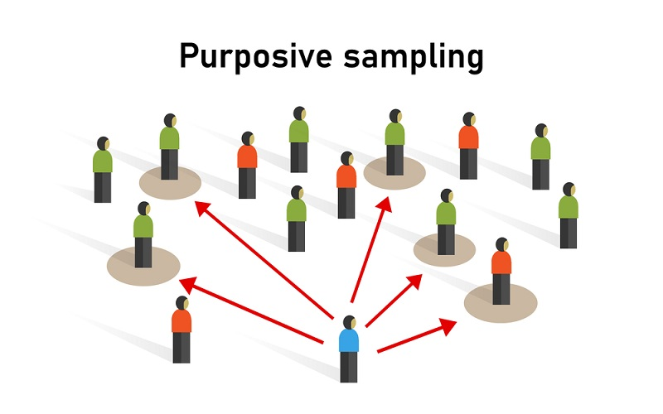
Ensuring Transferability Guba (1981)
Purposive sampling to choose the interviewees that are involved in this research
Purposive sampling is intentional selection of informants based on their ability to elucidate a specific theme, concept, or phenomenon.
A thick description must also be made.
Thick description refers to the detailed account of field experiences in which the researcher makes explicit the patterns of cultural and social relationships and puts them in context (Holloway, 1997).
By describing a phenomenon in sufficient detail one can begin to evaluate the extent to which the conclusions drawn are transferable to other times, settings, situations, and people.

Slide 21
Dependability (Guba 1981)
Not to be confused with consistency. Consistency is a trickier concept for natural research.
Assume that some portion of observed instability is ‘real’.
The concept of consistency implies not invariance (except by chance) but trackable variance-variance that can be ascribed to sources
The naturalist thus interprets consistency as dependability, a concept that embraces both:
stability implied by the rationalistic term reliable
trackability required by explainable changes in instrumentation

Slide 22
Ensuring Dependability (Guba 1981)
As suggested by Shenton (2004), the research steps have to be reported in detail
In accordance with Guba’s suggestion of audit trail, then the researcher must explain each chapter in sequential manner.

Slide 23
Confirmability (Guba 1981)
Naturalists are especially aware of the cultural and ethnic biases because they understand the multiple realities that one encounters (including multiple value systems) and the role that their own predispositions can play when they use themselves as instruments.
Naturalists shift the burden of neutrality from the investigator to the data, requiring evidence not of the certifiability of the investigator or his or her methods but of the confirmability of the data produced

Slide 24
Ensuring Confirmability
As suggested by Guba (1981) and Shenton (2004), the role of triangulation is emphasized.
As exemplified by Pielstick (2005), the original document sources and the original interviewees comments were cited extensively in the research.
As suggested by Guba (1981), practicing reflexivity is a must in conducting the research.

Slide 25
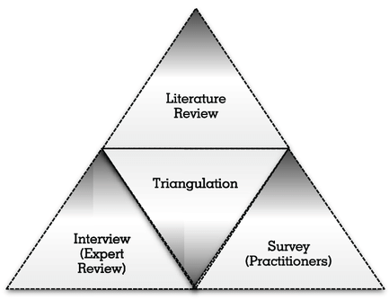
Triangulation
Triangulation involves using multiple data sources in an investigation
Rather than seeing triangulation as a method for validation or verification, qualitative researchers generally use triangulation to ensure that an account is rich, robust, comprehensive and well-developed.
Notes:
Some see triangulation as a method for corroborating findings and as a test for validity. This, however, is controversial. This assumes that a weakness in one method will be compensated for by another method, and that it is always possible to make sense between different accounts. This is unlikely.

Slide 26
Types of Triangulation (Denzin, 1978 and Patton, 1999)
http://www.qualres.org/HomeTria-3692.html
Methods triangulation
checking out the consistency of findings generated by different data collection methods.
Triangulation of sources
examining the consistency of different data sources from within the same method.
Analyst Triangulation
using multiple analysts to review findings or using multiple observers and analysts
Theory/perspective triangulation
using multiple theoretical perspectives to examine and interpret the data
Notes:
Methods triangulation - checking out the consistency of findings generated by different data collection methods.
It is common to have qualitative and quantitative data in a study
These elucidate complementary aspects of the same phenomenon
Often the points were these data diverge are of great interest to the qualiatitive researcher and provide the most insights
Triangulation of sources - examining the consistency of different data sources from within the same method. For example:
at different points in time
in public vs. private settings
comparing people with different view points
Analyst Triangulation - using multiple analyst to review findings or using multiple observers and analysts
This can provide a check on selective perception and illuminate blind spots in an interpretive analysis
The goal is not to seek consensus, but to understand multiple ways of seeing the data
Theory/perspective triangulation - using multiple theoretical perspectives to examine and interpret the data

